Slide 1

Google App Engine
Ping Yeh, Software Engineer
Chris Schalk, Developer Advocate

Slide 2
Problems building web applications
What is Google App Engine?
The App Engine Components
Preview Release features
Demo apps
Questions?

Slide 3
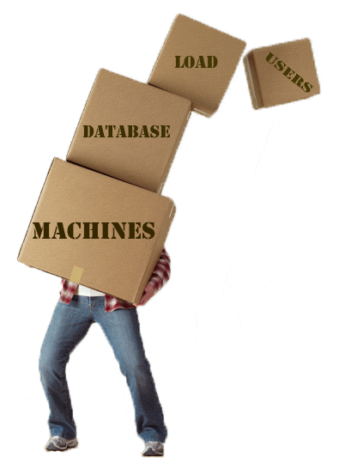
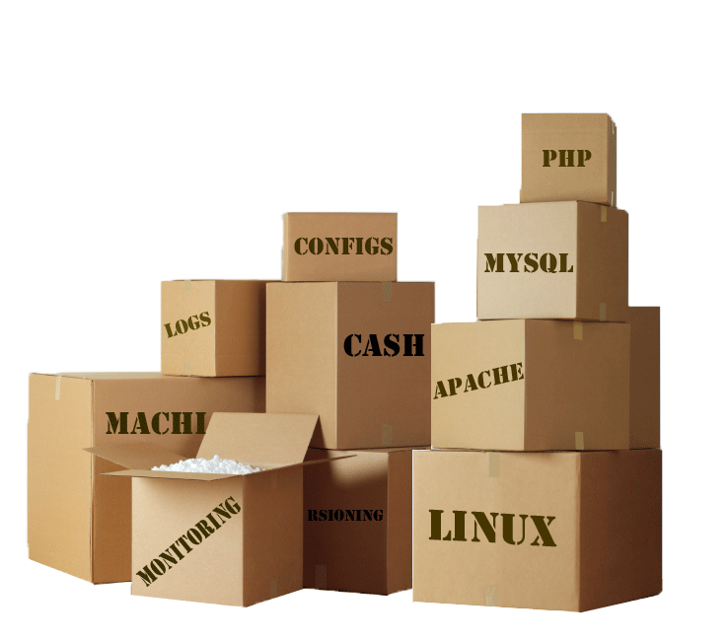
Google App Engine
Challenges building web apps

Slide 4
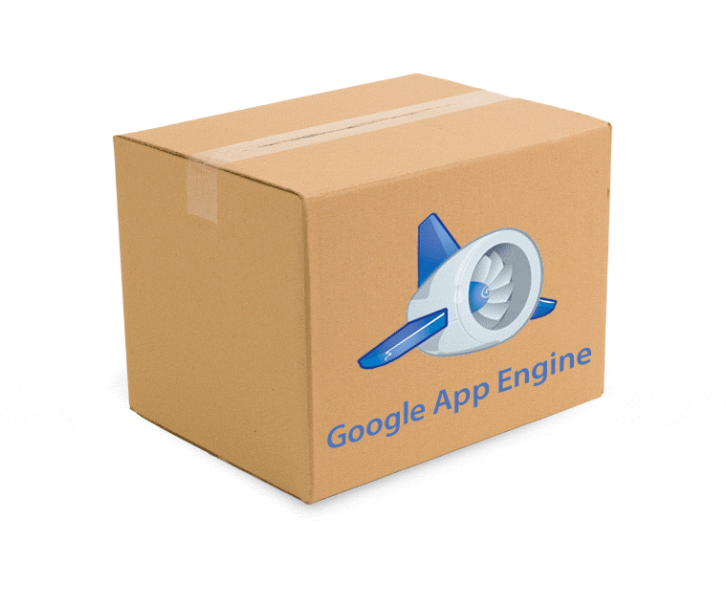
Run your web applications on Google Infrastructure

Slide 5
Easy to start.
Easy to scale.

Slide 6
The Components

Slide 7
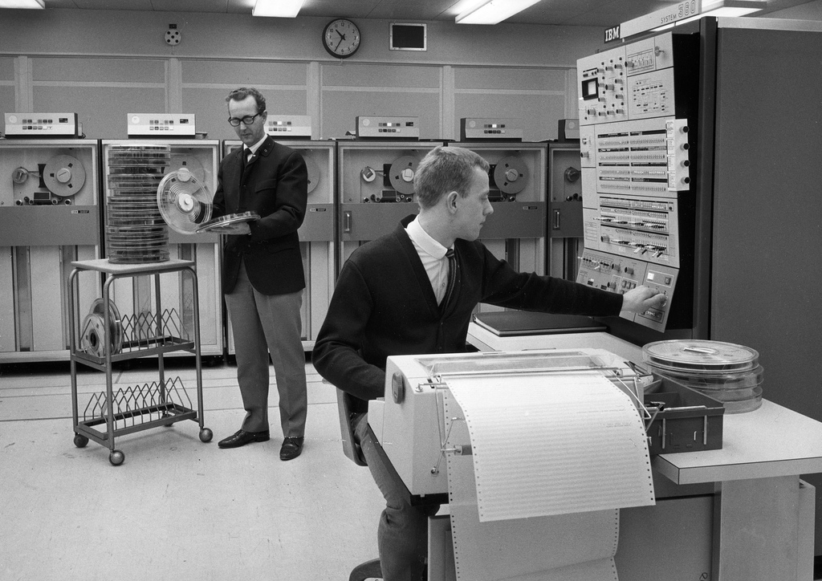
1. Scalable Serving Architecture
creative commons licensed photograph from cote

Slide 8
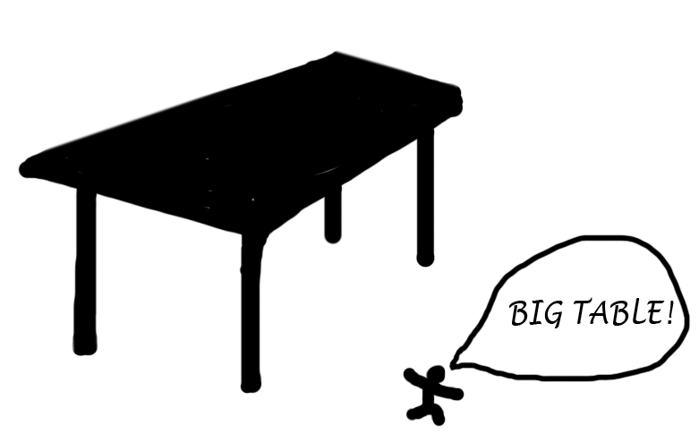
2. Distributed Datastore
Wow, that's a
big table!

Slide 9
Datastore Model Class
class Message(db.Model):
content = db.StringProperty(required=True)
who = db.StringProperty()
when = db.DateTimeProperty(auto_now_add=True)

Slide 10
GQL Query
db.GqlQuery(“SELECT * FROM Message ”
“WHERE who = :1”
“ORDER BY when DESC”, buddy_name).fetch(100)

Slide 11

3. Python Runtime & Libraries

Slide 12
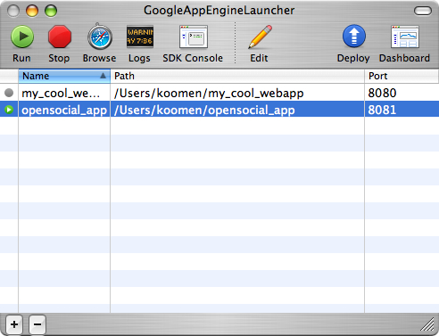
4. Software Development Kit

Slide 13
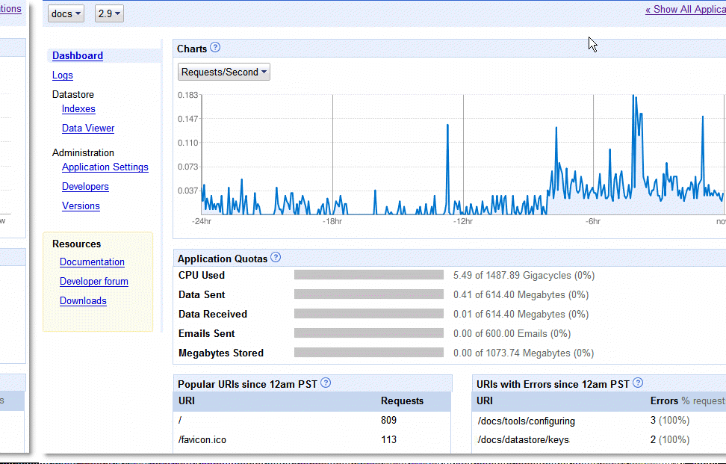
5. Web-based Admin Console

Slide 14
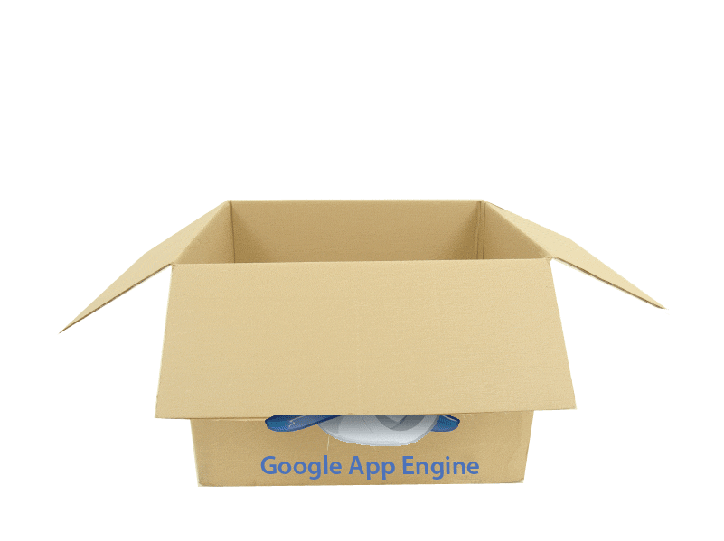
Memcache
Send E-Mail
Make HTTP Requests
Authenticate with Google Accounts
Image Manipulation

Slide 15
PREVIEW

Slide 16
Free to Get Started
500 MB Storage
11 GB Bandwidth / day
~ 5 Million Pageviews / month

Slide 17
Always
Free to Get Started
500 MB Storage
11 GB Bandwidth / day
~ 5 Million Pageviews / month

Slide 18
What’s Next?
More Languages
Purchase Additional Capacity
Large upload/download support
Offline Processing

Slide 19
Google App Engine
http://code.google.com/
Come join us in BoF!

